Slide 1
The secret to hiring great landscape employees A new approach in the ages of social media AND COVID-19
Presented by Ian Schotanus
The Big Picture Consulting

Slide 2
Where are you finding employees?
Indeed?
Zip Recruiter?
Craigslist?
Friends & Family?
All these resources, and you are still struggling to find quality employees?
Why aren’t these ‘tried and true methods’ working these days?

Slide 3
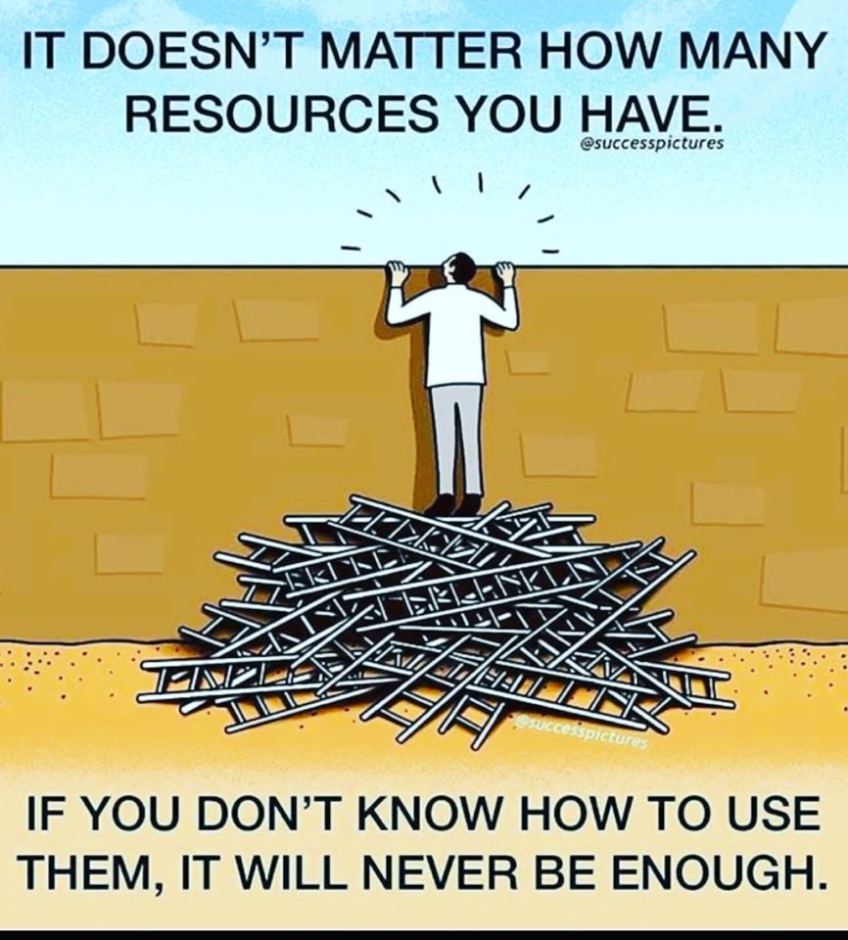

Slide 4
Tip #1: Craft a ‘Why’ story!
There is a reason why you started your business… To serve your customers! Now you need to sell the story behind it (or create a new one) to existing and potential employees!
WHY should an employee join your team?
WHAT makes you different than competitors?
HOW will you improve THEIR lives?
WHO are you looking for to help you?

Slide 5
Tip #2: Do not rely on finding job seekers!
Right now, everyone who WANTS
a job HAS a job!

Slide 6
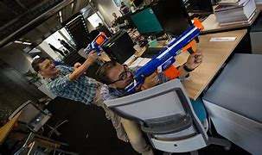
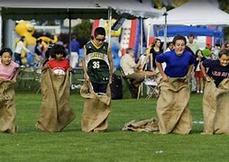
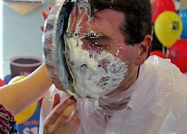
Tip #3: Use Social Media!
You are looking for new, engaging, and hopefully experienced people to join your team.
If THEY are not actively looking for work, you need to make them aware of your existence.
‘The grass is greener over here!’
Get THEIR friends and family to recruit for you!

Slide 7
Tip #4: Do not forget the basics!
Wage analysis…
Benefit offerings…
Brand Representation…
Professionalism…
Positivity!!!

Slide 8
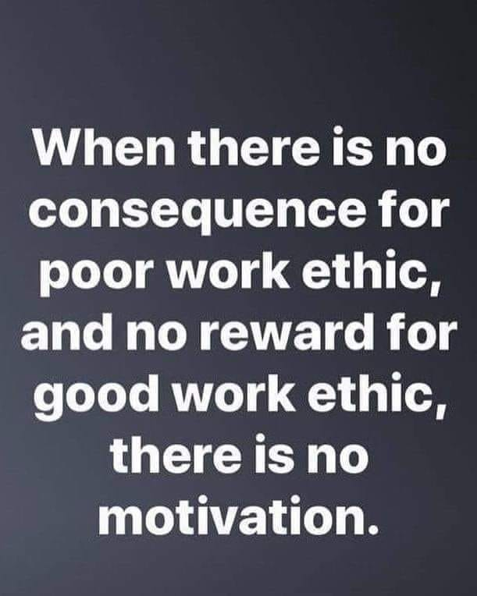
Tip #5: Reinforce your Why story!
You have gone through the effort to FIND and RECRUIT a new employee…
Now you need to keep them!
Make them feel welcome and WANTED from day 1!
Keep things fun, consistent, and equitable!
Accountability!

Slide 9
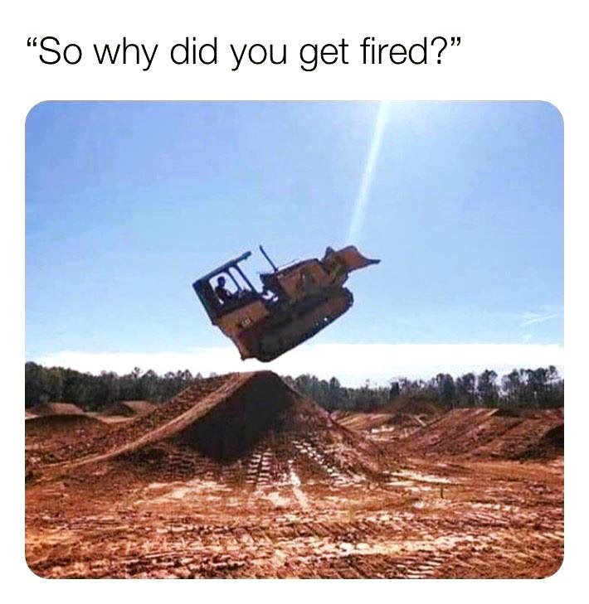
You have the employees… Now what?
The work must get done!
Onboarding – What it means to ‘Representing the Brand’
Training – How to do the work…
Company Standards
HR & Safety Compliance
Accountability – Despite our best efforts, employees, managers, and employers are still HUMAN!

Slide 10
Easier said than done… HOW do you do it?
Management & Leadership
Recruitment Objectives/Practices
Employee Handbook Policies
Compensation Management
Safety Program
Safety Manual
Safety Training
Conflict Resolution
Accountability

Slide 11
QUESTIONS – I know a Guy!
The Big Picture Consulting
Email: Support@TheBigPictureConsulting.com
Phone: (612)368-9616
Facebook: @TBPConsulting
Linkedin: the-big-picture-consulting
HR Business Partners: Dedicated to YOUR Peace of Mind!

